Slide 1
Tech Ninjas & Esports
Bryan Erskine
Director of Technology
Esports Coach
Clinton Community School District

Slide 2
In the Following
We will address what is a Tech Ninja Program?
How does a Tech Ninja program help the Tech Department?
How does a Tech Ninja program affect students?
We will address what are esports?
Why should I add esports?
How does the esports program affect Tech Ninjas?
How does the Tech Ninja program affect esports?
How does an esports program affect students?
How can these programs impact our budget?

Slide 3
What is a Tech Ninja Program?
A Tech Ninja is a student who actively participates in an IT program such as being a student teacher, intern, etc.

Slide 4
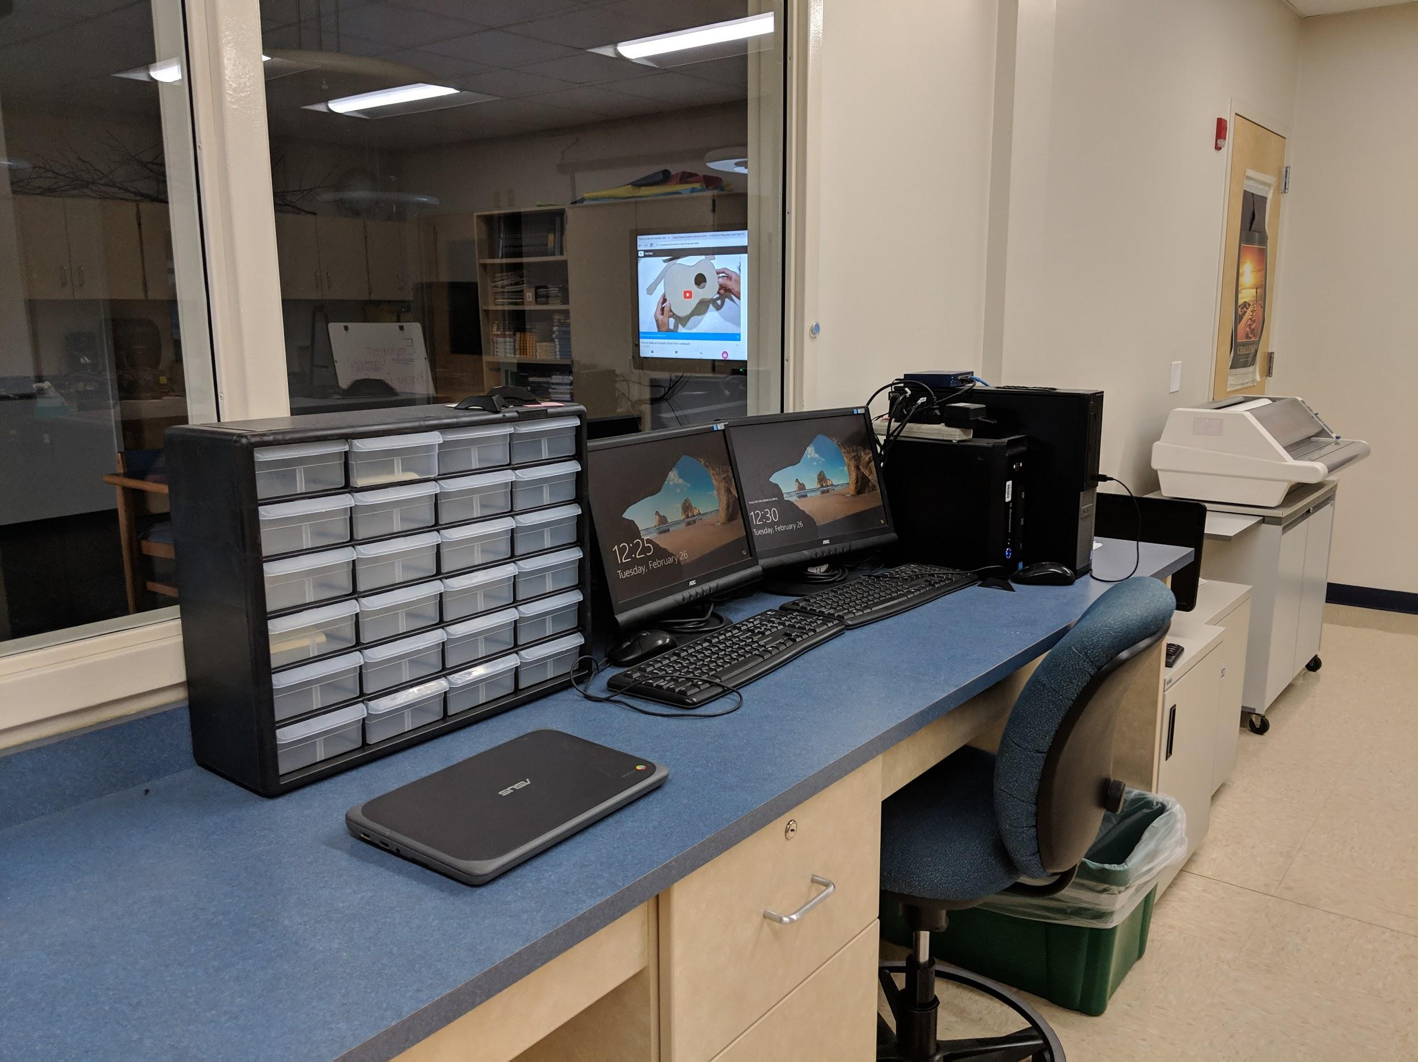

Slide 5
Experience with the Program
6 years of experience working with a Tech Ninja program
Each year it has evolved
Through doing this program I’ve had:
6 Students place 1st-3rd place in State at Skills USA in IT.
1 Student placed 15th at Nationals
1 Student received an internship and later a job with Robert W. Baird & Co.
8 Students received scholarships with MSOE
1 Student received a $40,000 sign on bonus with the US Navy
Almost all of these students went on to finish a 2 to 4 year degree in IT.

Slide 6
What do the Students do?
Students do a variety of tasks based on their skill levels. As each student is unique, and on a different level, all student will accomplish basic tasks, while others will go on to accomplish more advanced tasks.

Slide 7
Assignments
All Students
Do research based assignments:
Claude Shannon
Grace Hopper
Kevin Mitnick
Provide Customer support to fellow students
Fix Chromebooks
Students will begin to
Provide Customer support to teachers and staff.
Students will go with a tech to the classroom until the tech feels they are able to try a few on their own.

Slide 8
Issues Students may try to resolve
Beginners
Sound issues
Chromebook Issues
Chromebook Part Replacement
Some Google Issues
Intermediate
Google Issues
Software Issues
Software Research
Part Replacement
Desktop/Laptop
Power Issues
Display Issues
Advanced
Software Installation
Re-imaging
Scripting

Slide 9
Final Project
In the Final Project Students configure their own Server with DNS, DHCP, and AD.
Server is not connected to the Internet or School Network.
It uses a 5 port switch to connect to a desktop PC the students need to use to join to their domain.
Students must create 3 OUs, 5 users, 2 Distribution Groups, 1 Security Group, create 1-5 DHCP Scopes at minimum for the project then defend their rationale as to the structures of their Naming Schemes and Scopes.

Slide 10
Final Project
Advanced Students
Will also setup IIS, create scripts to add multiple users, or automate user creation.
Advanced students will utilize a 24 port Cisco Switch to setup VLANs for the Scopes and add two older Laptops wired to the switch to show they connected 3 client machines to 3 separate scopes.
Advanced Students also create a network based on a Business and show how they followed best practices in the naming schemes and scopes.

Slide 12
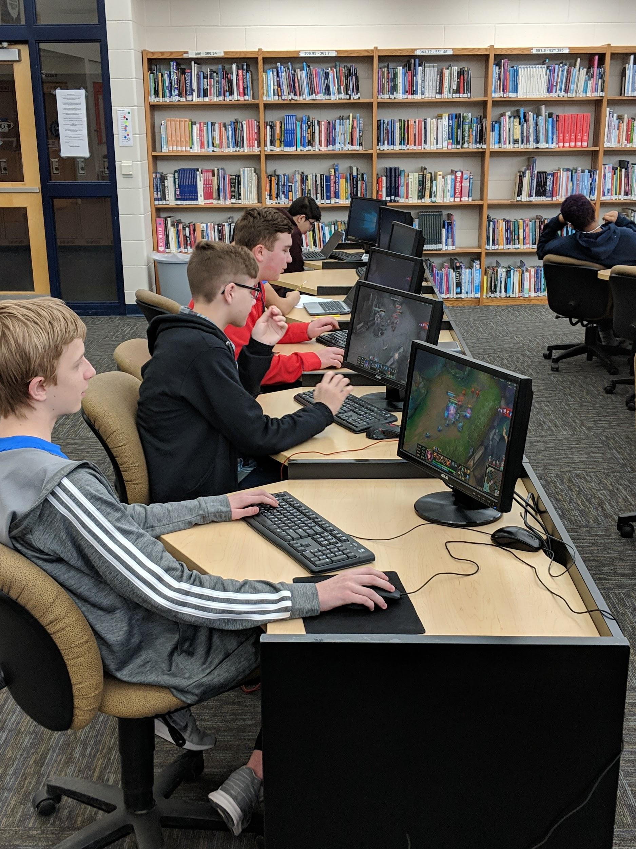
Esports
What are esports?

Slide 13
Esports are Electronic Sports (Video Games)
Games can include but are not limited to:
League of Legends
Overwatch
Rocket League
Super Smash Brothers
And more.
Student Competition:
Students compete in an 8 week season (currently) with a chance to go to the playoffs and make it to the State Competition.
Students also compete for college scholarships

Slide 14
Wait? Why Bring Video Games in?
For years we have tried to do everything we can to block games for students …. Now you want us to let them through?
Many of these Games cannot be played in a single class period.
They require a lot of concentration...
Many of these games have stiff penalties for leaving.
Many Schools have dedicated areas for play.

Slide 15
Esports are evolving
Only about 100 years ago many schools did not include any sport, or the arts.
Now can anyone imagine schools without these programs?
Esports is at this same junction.
NBA Viewership: Down 26% per year. 20.4 million 2018
MLB Viewership: Down 8.6% per year. Won’t List total viewership
NFL Viewership: Down 10% per year. 15.8 million 2018
Esports Viewership reached 173 million viewers in 2018.
Esports is expected to hit 201 million in 2019.
League of Legends alone was nearly 100 million viewers.

Slide 16
2015 LoL Worlds Arena - Sold out

Slide 17
Esports Evolution
In 2013 League of Legends set the record for the Staples Center selling out in under an hour.
Esports player’s salaries have just reached about $40,000 - $120,000 per year. Not including free housing and transportation, and other income such as endorsements and sponsorships.
Other sports teams such as the Milwaukee Bucks, Houston Rockets, and many others have started their own esports teams.

Slide 18
Importance of Esports in Schools
Esports targets all types of students including:
Students that are not engaged in other School Activities
It brings students of various social groups together
It works on skills that directly relate to the classroom/life:
Time Management
Communication
Planning
Mathematics
Students should not just show up and play games!
There are drills they can run to get better just like at other sports practices

Slide 19
Why bring up esports??
Esports are where many of my Tech Ninjas come from.
During esports we talk about important subjects such as FPS, internet connection types, various components, and how they affect game play.
This typically engages the students and makes them want to learn more, so they can improve their gameplay.
Most of my esports students have built their own computers.
Half of those students have already, or plan to become, a Tech Ninja.

Slide 20
Why bring up esports??
Esports is more than just the athletes!
To make esports work you have coaches, shout casters, analysts, marketers, accountants, managers, and many other positions associated with esports outside of just players.
Blizzard currently has positions for broadcasters, audio/sound, IT, engineers, analysts, HR, marketing, and many many others that don’t even include game design or being a player.
Many other companies such as Riot Games have similar job availabilities.

Slide 21
Curriculum
Orange County in California has recently created state supported curriculum surrounding esports.
Many Schools believe that instead of trying to eliminate the problem they would embrace and lean into the problem using it to their advantage.
Orange County is one of those and created curriculum in areas such as English, Business, and even Math that directly relate to esports.

Slide 22
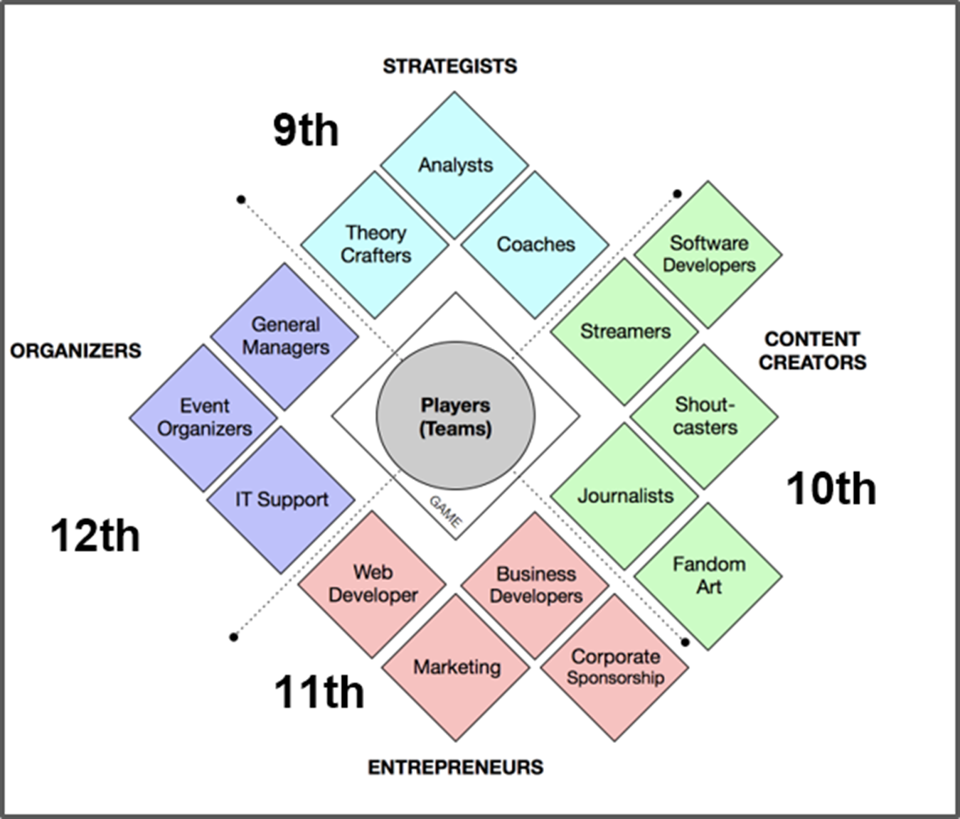

Slide 23
Curriculum
Utilizing esports can better engage students and give them a desire to learn school subjects, along with skills that relate to their interests.
The North American Scholastic Esports Federation, NASEF, has also begun building curriculum for esports.
English 9-12
https://www.esportsfed.org/resources/curriculum/

Slide 24
Want to get an esports team?
Wisconsin High School Esports Association
www.wihsea.org
Contact Mike Dahle President of WIHSEA
dahlemj24@gmail.com

Slide 25
Thank You For Attending!
Any questions?
Bryan Erskine
brerskine@clintonwis.com

